Slide 1

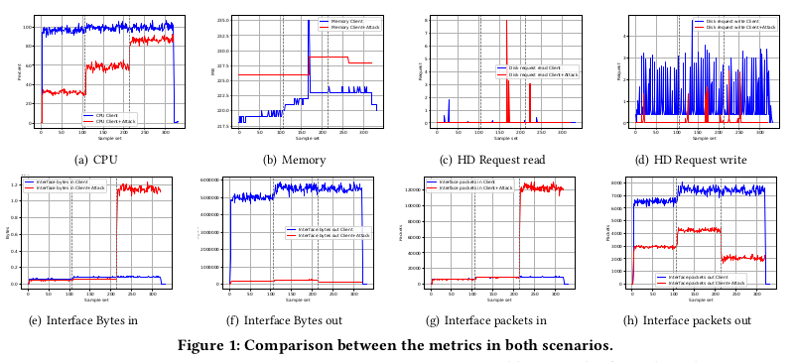
Sardar Patel Institute of Technology
Department of Computer Engineering
Academic Year 2019-20
Title: On Machine Learning DoS Attack Identification from
Cloud Computing Telemetry
Name:Ansari Mohd Saeem Mohd Saleem, M.E.(Comp.)
Project Guide(s) : Anant Nimkar
Abstract
The detection of Denial of Service (DoS) attacks remains a challenge for the cloud environment, affecting a massive number of services and applications hosted by such virtualized infrastructures. Typically, in the literature, the detection of DoS attacks is performed solely by analyzing the traffic of packets in the network. This work advocates for the use of telemetry from the cloud to detect DoS attacks using Machine Learning algorithms. Our hypothesis is based on richness of such native data collection services, with metrics from both physical and virtual hosts. Our preliminary results demonstrate that DoS can be identified accurately with k-Nearest Neighbors (kNN) and decision tree (CART).
Two test scenarios have been performed. In the first test there is only authorized and real clients, generating traffic at from users so that the web server can hold it. In the second test,however, along with authorized clients, SYN Flood attack is executed. During both tests, the following metrics are monitored by the OpenStack cloud: CPU and Memory usage, number of disk read requests, number of disk write requests,rate of incoming and outgoing Bytes in each network interface, rate of incoming and outgoing packets in each network interface.
Result
Accuracy
Conclusion
On the basis of obtained result, proposal used data from the resources usage from cloud computing environment and successfully detect whether TCP/SYN Dos attack is happens or not.
Also we can conclude that accuracy of KNN algorithm is much better than CART technique.
References
[1] P. Amaral, J. Dinis, P. Pinto, L. Bernardo, J. Tavares, and H. S. Mamede 2016. Machine Learning in Software Defined Networks: Data collection and traffic classification. In 2016 IEEE 24th International Conference on Network Protocols (ICNP).
[2] Verisign. 2018. What Is a DDoS Attack? https://www.verisign.com/en_US/security-services/ddos-rotection/what-is-a-ddos-attack/index.xhtml. (2018). Accessed: 2019-03-11.
[3] Z. Fadlullah, F. Tang, B. Mao, N. Kato, O. Akashi, T. Inoue, and K. Mizutani. 2017. State-of-the-Art Deep Learning: Evolving Machine Intelligence Toward Tomorrow’s Intelligent Network Traffic Control Systems.
Introduction
The migration of traditional services and applications to centralized cloud environments amplifies their vulnerability to disruption in relation to the impact of DoS attacks performed over conventional architectures. Thus, there is an urgent need to perform the identification and characterization of DoS traffic in cloud environments. In general,there are three ways to perform traffic classification: i) identification using TCP/UDP port numbers; ii) inspecting the contents of the network packets; and, finally, iii) applying Machine Learning (ML) techniques to network data source [1]. This paper advances the latter, and proposes the use of ML algorithms in order to distinguish malicious traffic from legitimate traffic from clients in a cloud environment.
Aim
Identification of Dos attack in cloud computing.
Objective(s)
1. Collects Traffic data
2. Classify and analyze current traffic data
3. Take decision whether environment is under attack or not
Problem Definition
Identification and detection of Dos attack specifically TCP SYN flood attack in cloud computing environment.
Methodology
An experimental setup has been created with an OpenStack cloud (Rocky version), containing a web server using Apache2, virtual machine simulating legitimate web clients with Siege 1. Finally, another host performs the role of malicious users and generates the SYN Flood Attack with hping3.
Algorithm | Accuracy(%)
KNN | 99.3
CART | 91.07

